Slide 1
Illumination Models & Surface-Rendering Methods
Illumination model or a lighting model is the model for calculating light intensity at a single surface point.
Surface rendering is a procedure for applying a lighting model to obtain pixel intensities for all the projected surface positions in a scene.

Slide 2
Illumination models
Given the parameters:
the optical properties of surfaces (opaque/transparent, shiny/dull, surface-texture);
the relative positions of the surfaces in a scene;
the color and positions of the light sources;
the position and orientation of the viewing plane.
Illumination models calculate the intensity projected from a particular surface point in a specified viewing direction.
Notes:
To minimize intensity calculations, most packages use empirical models based on simplified photometric calculations.

Slide 3
Light Sources
When we view an opaque nonluminous object, we see reflected light from the surfaces of the object.
The total reflected light is the sum of the contributions from light sources and other reflecting surfaces in the scene.
Light sources = light-emitting sources.
Reflecting surfaces = light-reflecting sources.

Slide 4
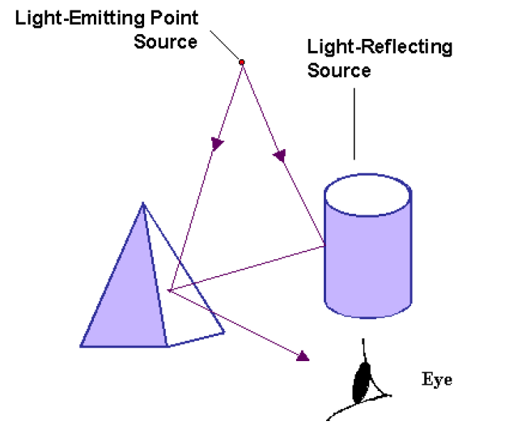
Light Sources
Fig. 1 Light viewed from an opaque surface is in general a combination of reflected light from a light source and reflections of light reflections from other surfaces.

Slide 5
Point Light Source
The rays emitted from a point light radially diverge from the source.
Point sources are abstraction of
real-world sources of light such as
light bulbs, candles, or the sun.
The light originates at a particular
place; it comes from a particular direction over a particular distance.
Surfaces facing towards and positioned near the light source will receive more light than those facing away from or far removed from the source following radially diverging paths as shown in fig. 2.
Fig. 2
Diverging ray paths from a point light source.

Slide 6
Distributed Light Source
A nearby source, such as
the long fluoresent light.
All of the rays from a
directional/distributed
light source have the
same direction, and no
point of origin.
It is as if the light source was infinitely far away from the surface that it is illuminating.
Sunlight is an example of an infinite light source.
Fig. 3
An object illuminated with a distributed light source.

Slide 7
Materials
When light is incident on an opaque surface, part of it is reflected and part is absorbed.
Shiny materials reflect more of the incident light, and dull surface absorb more of the incident light.
For an illuminated transparent surface, some of the incident light will be reflected and some will be transmitted through the material.

Slide 8
Diffuse reflection
Grainy surfaces scatter the reflected light in all directions. This scattered light is called diffuse reflection.
The surface appears equally bright from all viewing directions.
What we call the color of an object is the color of the diffuse reflection of the incident light.
Fig. 4
Diffuse reflection from a surface.

Slide 9
Specular reflection
Light sources create highlights, bright spots, called specular reflection. More pronounced on shiny surfaces than on dull.
Fig. 5
Specular reflection superimposed on diffuse reflection vectors.

Slide 10
Basic Illumination Models
Lighting calculations are based on:
Optical properties of surfaces, such as glossy, matte, opaque, and transparent. This controls the amount of reflection and absorption of incident light.
The background lighting conditions.
The light-source specifications. All light sources are considered to be point sources, specified with a coordinate position and intensity value (color).

Slide 11
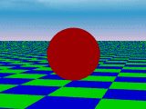
Ambient Light
A surface that is not directly exposed
to a light source will still be visible if
nearby objects are illuminated due to
light reflecting from nearby objects.
Ambient light has no spatial or
directional characteristics.
The amount of ambient light incident on each object is a constant for all surfaces and over all directions.
The amount of ambient light that is reflected by an object is constant for all surfaces and over all direction, but the intensity of reflected light for each surface depends only on the optical properties of the surface.
Fig. 6
Ambient light shading.

Slide 12
Ambient Light
The level of ambient light in a scene is a parameter I_{a} , and each surface illuminated with this constant value.
Illumination equation for ambient light is
I = k_{a}I_{a}
where
I is the resulting intensity
I_{a} is the incident ambient light intensity
k_{a} is the object’s basic intensity, ambient-
reflection coefficient or ambient reflectivity.

Slide 13
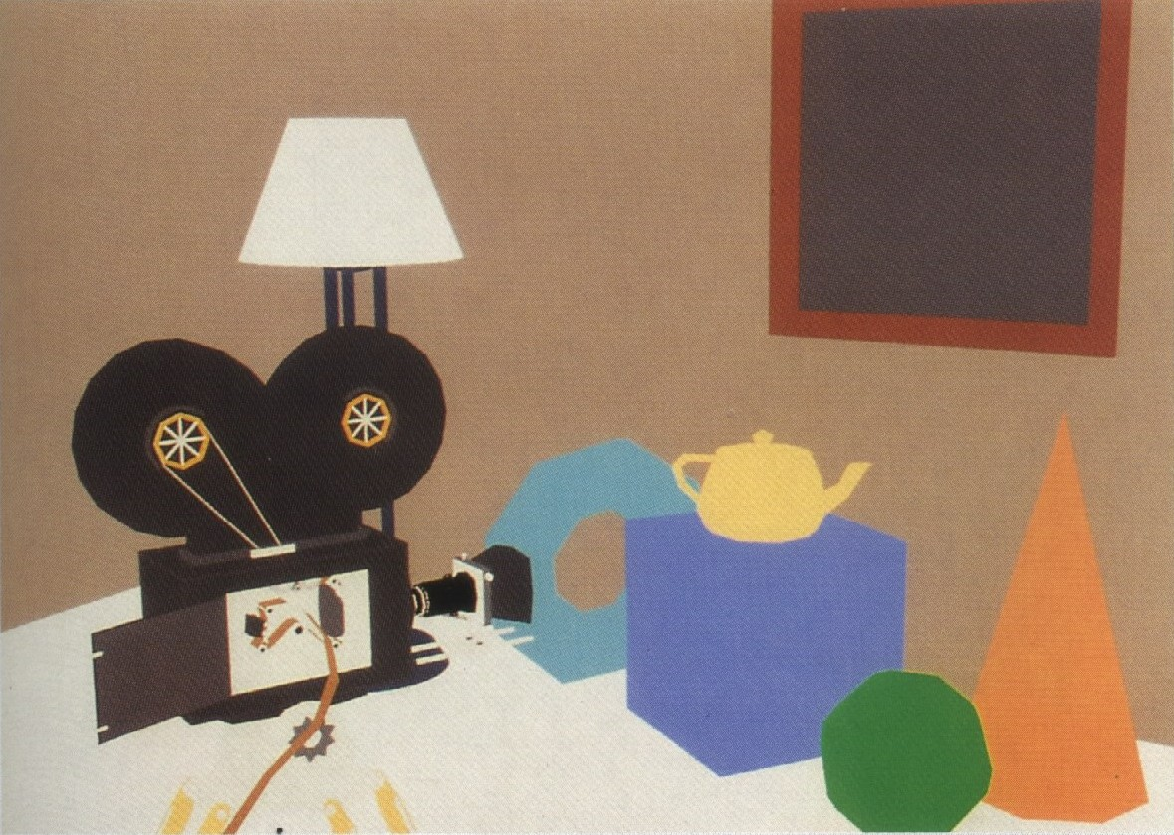
Ambient Light - Example
Fig. 7 An ambient illumination only.
Notes:
Since ambient light produces a flat shading for each surface (Fig. 6 and 7), at least one light source is included in a scene, often as a point source at the viewing position.

Slide 14
Diffuse Reflection
Diffuse reflections are constant over each surface in a scene, independent of the viewing direction.
The amount of the incident light that is diffusely reflected can be set for each surface with parameter k_{d}, the diffuse-reflection coefficient, or diffuse reflectivity.
0 ≤ k_{d} ≤ 1;
k_{d} near 1 – highly reflective surface;
k_{d} near 0 – surface that absorbs most of the
incident light;
k_{d} is a function of surface color;

Slide 15
Diffuse Reflection
Even though there is equal light scattering in all direction
from a surface, the brightness of the surface does depend
on the orientation of the surface relative to the light
source:
(a)
(b)
Fig. 8 A surface perpendicular to the direction of the incident light (a) is more illuminated than an equal-sized surface at an oblique angle (b) to the incoming light direction.

Slide 16
Diffuse Reflection
As the angle between the surface normal and the incoming light direction increases, less of the incident light falls on the surface.
We denote the angle of incidence between the incoming light direction and the surface normal as θ. Thus, the amount of illumination depends on cosθ. If the incoming light from the source is perpendicular to the surface at a particular point, that point is fully illuminated.

Slide 17
Diffuse Reflection
If I_{l} is the intensity of the point
Light source, then the diffuse
reflection equation for a point
on the surface can be written as
I_{l,diff} = k_{d}I_{l}cosθ
or
I_{l,diff} = k_{d}I_{l}(N.L)
where
N is the unit normal vector to a surface and L is the
unit direction vector to the point light source from a
position on the surface.
N
To Light Source
L
θ
Fig. 9
Angle of incidenceθ between the unit light-source direction vector L and the unit surface normal N.

Slide 18
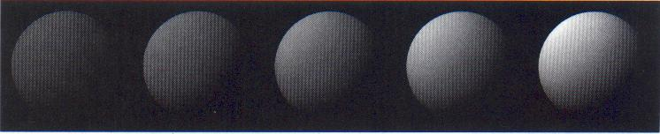
Diffuse Reflection
Figure 10 illustrates the illumination with
diffuse reflection, using various values of
parameter k_{d} between 0 and1.
Fig. 10
Series of pictures of sphere illuminated by diffuse reflection model only using different k_{d} values (0.4, 0.55, 0.7, 0.85,1.0).

Slide 19
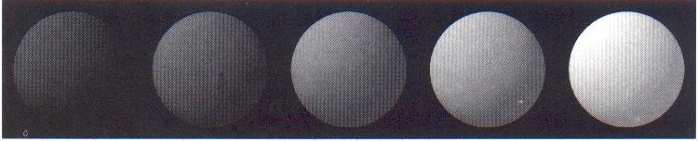
Diffuse Reflection
We can combine the ambient and point-source
intensity calculations to obtain an expression for the
total diffuse reflection.
I_{diff} = k_{a}I_{a}+k_{d}I_{l}(N.L)
where both k_{a} and k_{d} depend on surface material
properties and are assigned values in the range from
0 to 1.
Fig. 11 Series of pictures of sphere illuminated by ambient and diffuse reflection model.
I_{a} = I_{l} = 1.0, k_{d} = 0.4 and k_{a} values (0.0, 0.15, 0.30, 0.45, 0.60).

Slide 20
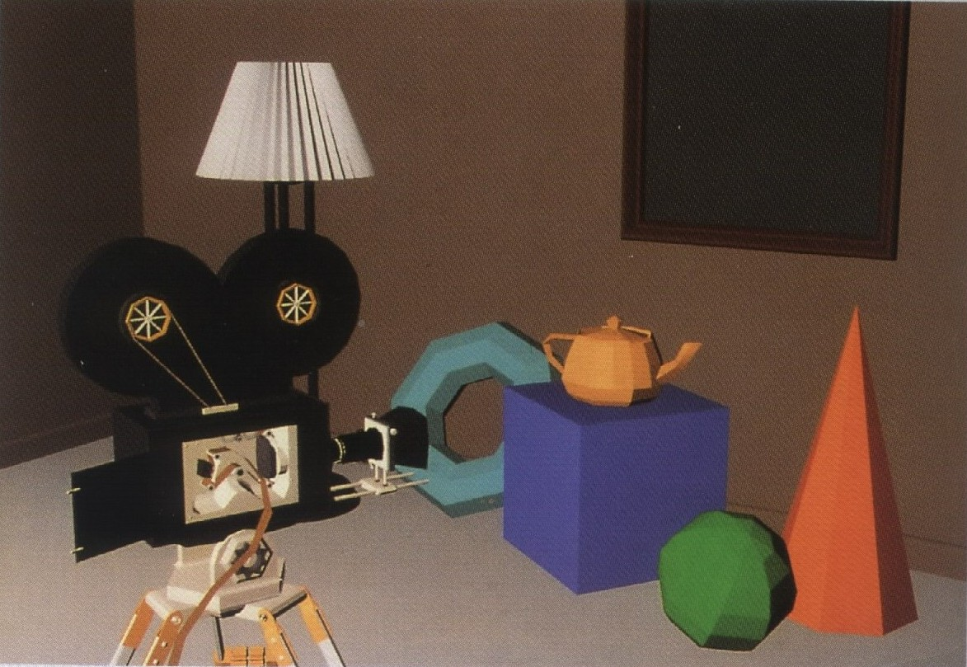
Diffuse Reflection - Example
Fig. 12 Individually shaded polygons with diffuse reflection.

Slide 21
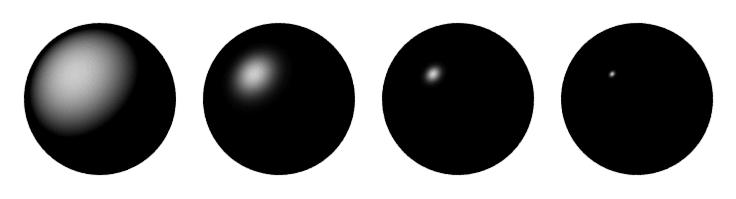
Specular Reflection and the Phong Model
Specular reflection is the result of total, or near total, reflection of the incident light in a concentrated region around the specular-reflection angle.
Shiny surfaces have a narrow specular-reflection range.
Dull surfaces have a wider reflection range.

Slide 22
Specular Reflection
Figure 13 shows the specular reflection
direction at a point on the
illuminated surface. In this figure,
R represents the unit vector in
the direction of specular reflection;
L – unit vector directed toward the
point light source;
V – unit vector pointing to the viewer from the surface position;
Angle Φ is the viewing angle relative to the specular-reflection direction R.
N
To Light Source
R
L
θ
θ
Φ
V
Fig. 13
Modeling specular reflection.

Slide 23
Phong Specular-Reflection Model
Phong specular-reflection model is an empirical model for calculating the specular-reflection range:
Sets the intensity of specular reflection proportional to cos^{ns}Φ;
Angle Φ assigned values in the range 0º to 90º, so that cosΦ values from 0 to 1;
Specular-reflection parameter n_{s} is determined by the type of surface,
Specular-reflection coefficient k_{s} equal to some value in the range 0 to 1 for each surface.

Slide 24
Phong Specular-Reflection Model
The intensity of specular reflection depends on the materials properties of the surface and the angle of incidence, as well as other factors such as the polarization and color of the incident light.
According to Fresnel’s Laws of Reflection,
Phong specular-reflection model is given as:
I_{spec} = W(ϴ)I_{l} cos^{ns}Φ
Where W(ϴ) is a monochromatic specular-reflection coefficient and ϴ=0º to ϴ=90º or W(ϴ)=0 to W(ϴ)=1

Slide 25
Phong Specular-Reflection Model
Very shiny surface is modeled with a large value for n_{s} (say, 100 or more);
Small values are used for duller surfaces.
For perfect reflector (perfect mirror), n_{s} is infinite;
N
N
R
R
L
L
Shiny Surface (Large n_{s})
Dull Surface
(Small n_{s})
Fig. 14
Modeling specular reflection with parameter n_{s}.
Notes:
very shiny surface is modeled with a large value for n_{s} (say, 100 or more), and small values are used for duller surfaces. For perfect reflector (perfect mirror), n_{s} is infinite;

Slide 26
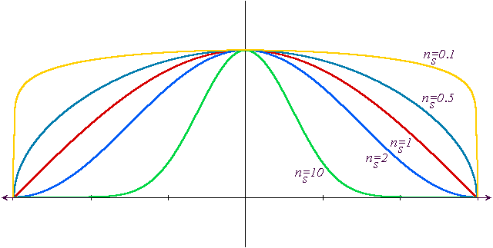
Phong Specular-Reflection Model
cos^{ns}Φ
Φ
Fig. 15
Plots of cos^{ns}Φ for several values of specular parameter n_{s}.
Notes:
very shiny surface is modeled with a large value for n_{s} (say, 100 or more), and small values are used for duller surfaces. For perfect reflector (perfect mirror), n_{s} is infinite;

Slide 27
Phong Specular-Reflection Model
Phong specular-reflection model:
I_{spec} = k_{s}I_{l} cos^{ns}Φ
Since V and R are unit
vectors in the viewing
and specular-reflection
directions, we can
calculate the value of
cos^{ns}Φ with the dot
product V.R.
I_{spec} = k_{s}I_{l} (V.R)^{ns}
N
To Light Source
R
L
θ
θ
Φ
V
Fig. 13
Modeling specular reflection.
Notes:
very shiny surface is modeled with a large value for n_{s} (say, 100 or more), and small values are used for duller surfaces. For perfect reflector (perfect mirror), n_{s} is infinite;

Slide 28
Phong Specular-Reflection Model
L
N
R
L
N.L
Fig. 16
Calculation of vector R by considering projections onto the direction of the normal vector N.
R + L = (2N.L)N
R = (2N.L)N-L
Notes:
very shiny surface is modeled with a large value for n_{s} (say, 100 or more), and small values are used for duller surfaces. For perfect reflector (perfect mirror), n_{s} is infinite;

Slide 29
Phong Specular-Reflection Model
N
H
L
R
α
Φ
V
Fig. 17
Halfway vector H along the bisector of the angle between L and V.
α = Φ/2
H = (L + V)/|(L + V)|
I_{spec} = k_{s}I_{l} (N.H)^{ns}

Slide 30
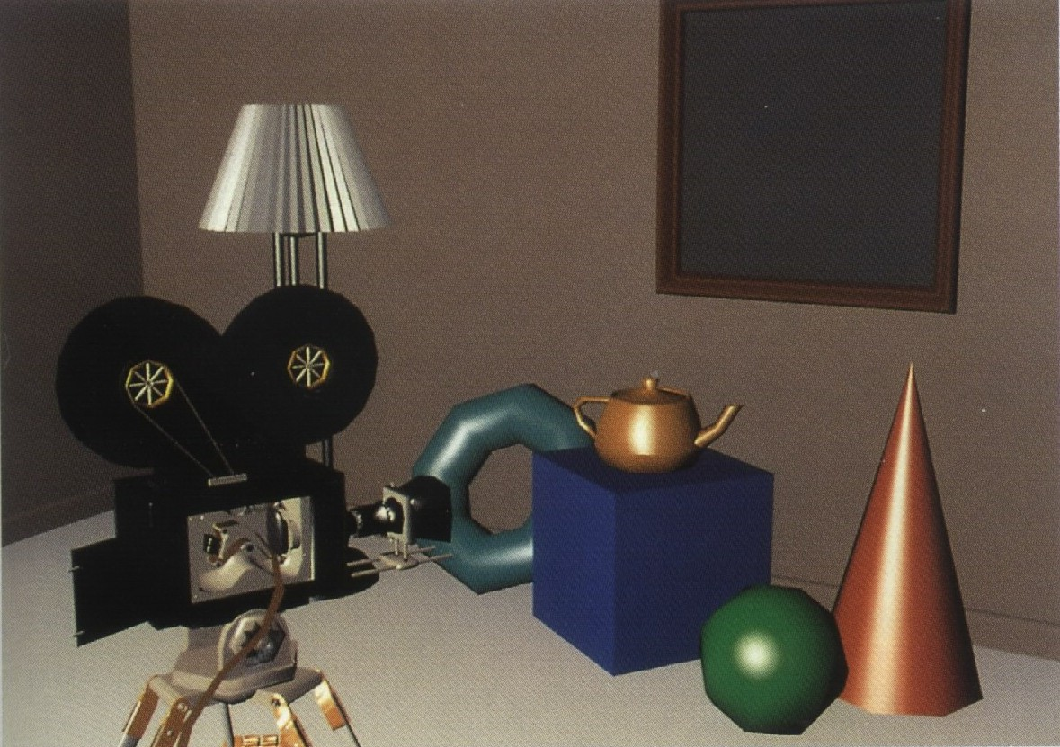
Specular Reflection - Example
Fig. 18
Phong shading polygons with specular reflection.

Slide 31
Combine Diffuse & Specular Reflections
For a single point light source, we can model
the combined diffuse and specular reflections
from a point on an illuminated surface as
I = I_{diff} + I_{spec}
= k_{a}I_{a} + k_{d}I_{l}(N.L) + k_{s}I_{l}(N.H)^{ns}

Slide 32
Combine Diffuse & Specular Reflections with Multiple Light Sources
If we place more than one point source in a
scene, we obtain the light reflection at any
surface point by summing the contributions
from the individual sources:
I = k_{a}I_{a} + Σ^{n}_{i=1} I_{li} [k_{d} (N.L_{i}) + k_{s}(N.H_{i})^{ns}]

Slide 33
Intensity Attenuation
As radiant energy from a point light source travels through space, its amplitude is attenuated by the factor 1/d², where d is the distance that the light has traveled.
A surface close to the light source (small d) receives a higher incident intensity from the source than a distant surface (large d).

Slide 34
Intensity Attenuation
Problem in using the factor 1/d² to attenuate
intensities:
The factor 1/d² produces too much intensity variations when d is small, and it produces very little variation when d is large.
We can compensate for these problems by using inverse linear or quadratic functions of d to attenuate intensities.

Slide 35
Attenuation Function
A general inverse quadratic attenuation function:
The value of the constant term a₀ can be adjusted to prevent f(d) from becoming too large when d is very small.

Slide 36
Attenuation Function
With a given set of attenuation coefficients, we can limit the magnitude of the attenuation function to 1 with the calculation
Using this function, we can then write our basic illumination model as
where d_{i} is the distance light has traveled from light source i.

Slide 37
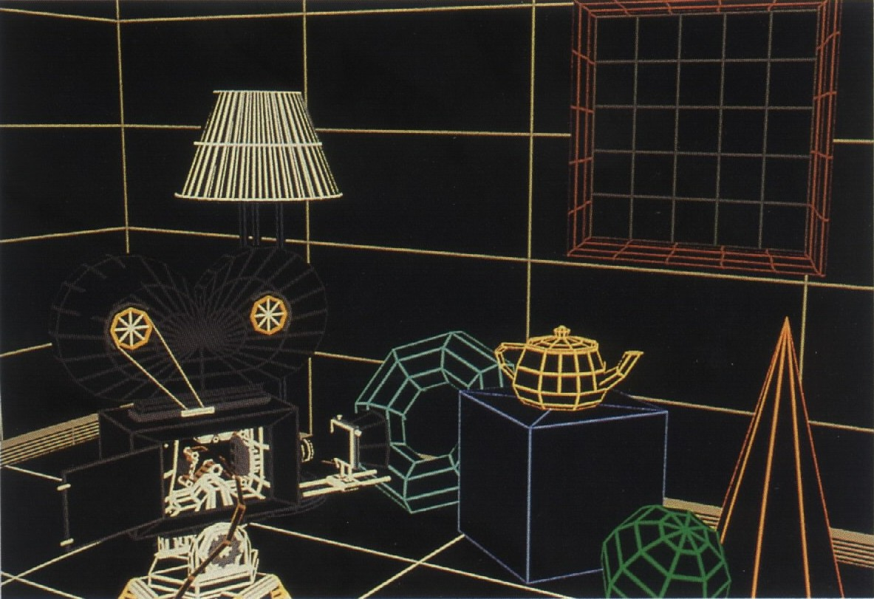
Visible-line determination

Slide 38
Visible-surface determination with ambient illumination only

Slide 39
Individually shaded polygons with diffuse reflection

Slide 40
Phong shaded polygons with specular reflection

Slide 41
Surface rendering
Surface rendering can be performed by applying the illumination model to every visible surface point, or the rendering can be accomplished by interpolating intensities across the surface from a small set of illumination-model calculations.
Scan-line algorithms use interpolation schemes.
Surface-rendering procedures are termed surface-shading methods.

Slide 42
Shadows
Hidden-surface methods can be used to locate areas where light sources produce shadows.
Apply a hidden-surface method with a light source at a view position.
Shadow patterns generated by a hidden-surface method are valid for any selected viewing position, as long as the light-source positions are not changed.
In polygon-based system, we can add surface-detail polygons that correspond to shadow areas of surface polygons.
We can display shadow areas with ambient light intensity only, or we can combine the ambient light with specified surface texture.

Slide 43
Polygon Rendering Methods
The application of an illumination model to the rendering of standard graphic objects;
Three methods, each of them treats a single polygon independent of all others (non-global):
Constant-Intensity Shading / Flat Shading;
Intensity-Interpolation Shading / Gourad Shading;
Normal-vector Interpolation Shading / Phong Shading
Each polygon can be rendered with a single intensity, or the intensity can be obtained at each point of the surface using an interpolation scheme.

Slide 44
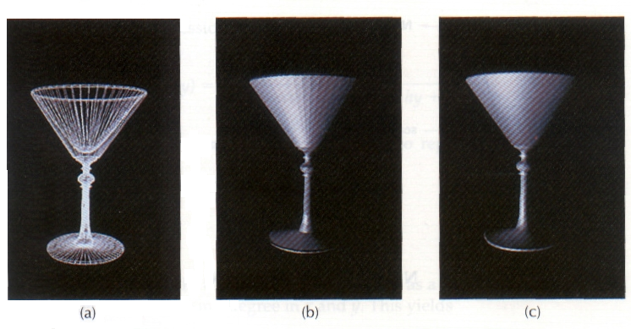
Polygon Rendering Methods
A polygon mesh approximation of an object (a) is rendered with flat shading (b) and with Gouraud shading (c).

Slide 45

Constant-Intensity Shading Flat Shading
Fast & simple.
A single intensity is calculated for each polygon.
All points over the surface of the
polygon are displayed with
the same intensity value.
Useful for quickly
displaying the general
appearance of a curved surface.

Slide 46
Flat Shading
Flat shading provides an accurate rendering for an object if all of the following assumptions are valid:
The object is a polyhedron and is not an approximation of an object with a curved surface;
All light sources illuminating the object are far from the surface so that N.L and the attenuation function are constant over the surface;
The viewing position is also far from the surface so that V.R is constant over the surface;

Slide 47
Gouraud Shading
Intensity-interpolation scheme, referred to as Gouraud shading, renders a polygon surface by linearly interpolating intensity values across the surface.
Intensity values for each polygon are matched with the values of adjacent polygons along the common edges, thus eliminating the intensity discontinuities that can occur in flat shading.

Slide 48
Gouraud Shading
Each polygon surface is rendered with Gouraud
shading by performing the following calculations:
Determine the average unit normal vector at each polygon vertex;
Apply an illumination model to each vertex to calculate the vertex intensity;
Linearly interpolate the vertex intensities over the surface of the polygon;

Slide 49
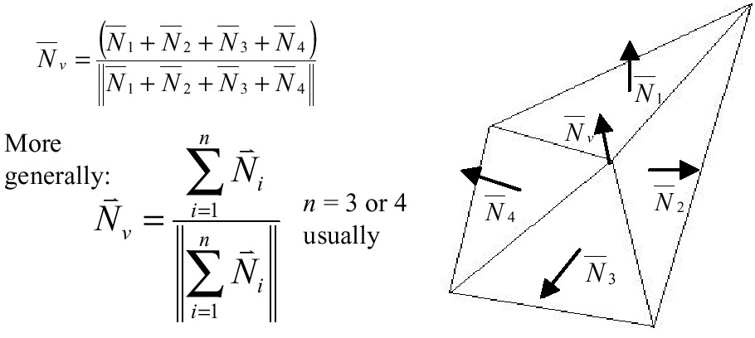
Gouraud Shading - Step 1
Step 1:
The normal vector N_{v} is calculated as the average of the surface normals for each polygon sharing that vertex

Slide 50
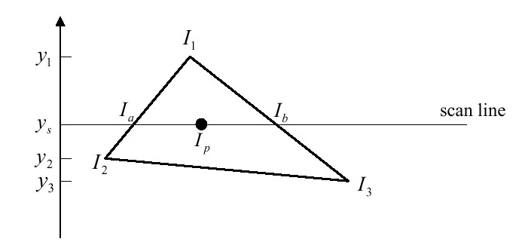
Gouraud Shading - Step 3
For each scan line, the intensity at the intersection of the scan line with a polygon edge is linearly interpolated from the intensities at the edge endpoints.

Slide 51
Gouraud Shading - Step 3
A fast method for obtaining this intensity is to interpolate between intensities of endpoints by using only the vertical displacement of the scan line:
and

Slide 52
Gouraud Shading - Step 3
Once these bounding intensities are established for a
scan line, an interior point (such as p) is interpolated
from the bounding intensities at points a and b as

Slide 53
Gouraud Shading - Step 3
Incremental calculations:
If the intensity at edge position
(x,y) is interpolated as
then we can obtain the intensity along this edge for
the next scan line, y-1, as
Similar calculations are used to obtain intensities at
horizontal pixel positions along each scan line.
I₁
I
y
scan lines
y-1
I’
I₂
x
x+1

Slide 54
What Gouraud shading misses:
Highlights on the surface are sometimes displayed with anomalous shapes.
Can cause bright or dark intensity streaks to appear on the surface (Mach-band effect).
Dividing the surface into a greater number of
polygon faces can reduce these effects.

Slide 55
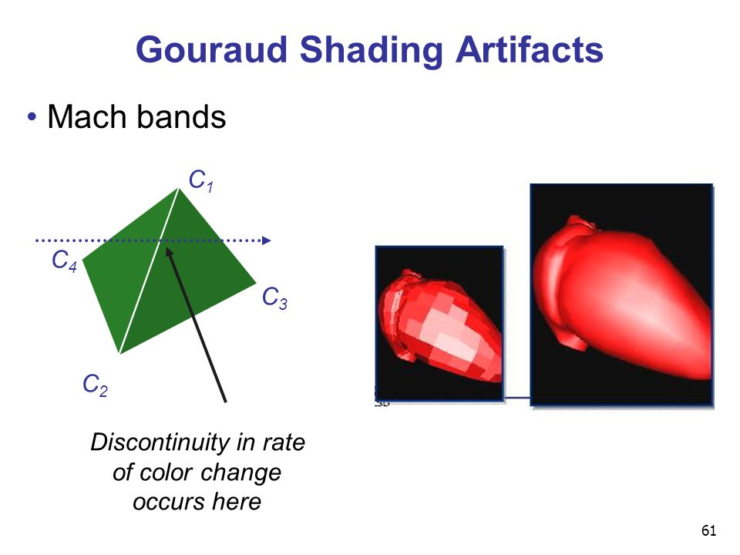
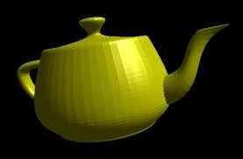

Slide 56
Phong Shading
A more accurate method for rendering a polygon surface.
Interpolates normal vectors, and then applies the illumination model to each surface point.
Method developed by Phong Bui Tuong.
Called Phong shading, or normal-vector interpolation shading.
More realistic highlights.
Greatly reduces the Mach-band effect.

Slide 57

Phong Shading

Slide 58
Phong Shading Steps:
Determine the average unit normal vector at each polygon vertex.
Linearly interpolate the vertex normals over the surface of the polygon.
Apply illumination model along each scan line to calculate projected pixel intensities for the surface points.

Slide 59
Phong Shading - Step 2
The normal vector N for the scan
line intersection point along the
edge between vertices 1 and 2
can be obtained by vertically
interpolating between edge
endpoint normals:
Incremental methods are used to evaluate normals
between scan lines and along each individual scan
line.
N₃
N₁
N
scan line
N₂

Slide 60
Phong Shading – Step 2
N₃
N₁
N₄
N_{p}
Scan line
p
N₅
N₂

Slide 61
Phong Shading
Produce more accurate results.
Trade-off: Phong shading requires a lot of calculations.
Bishop & Weimer developed Fast Phong Shading approximation using Taylor series expansion.
Fast Phong Shading (See yourself)

Slide 62
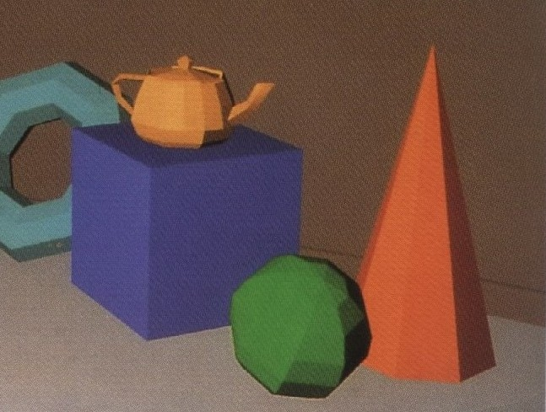
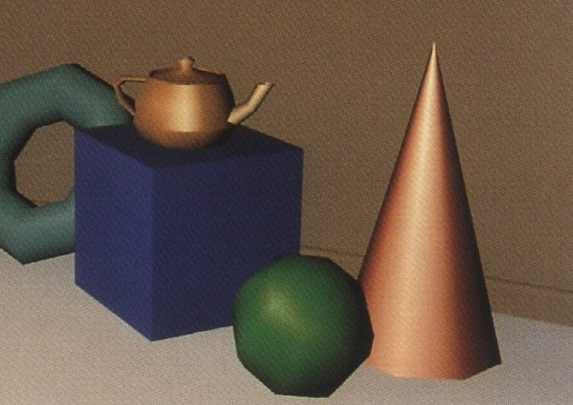
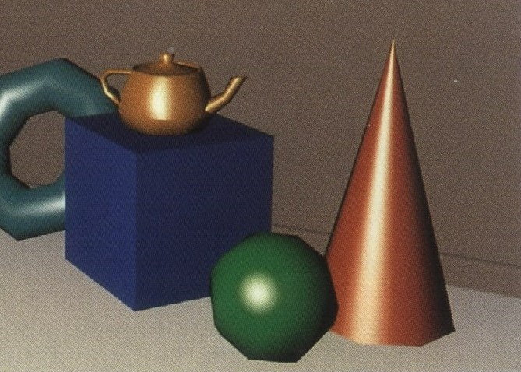
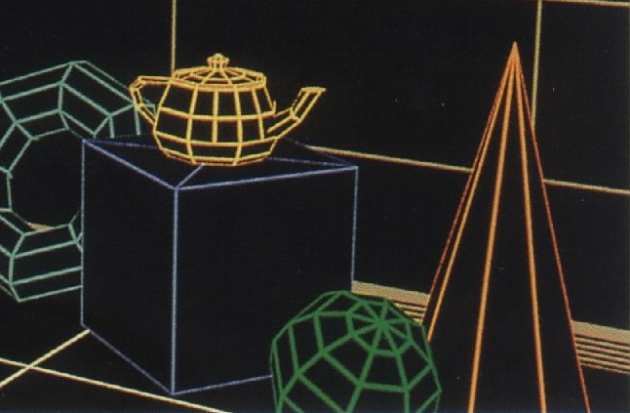
Polygon Shading Methods - Example

Slide 63

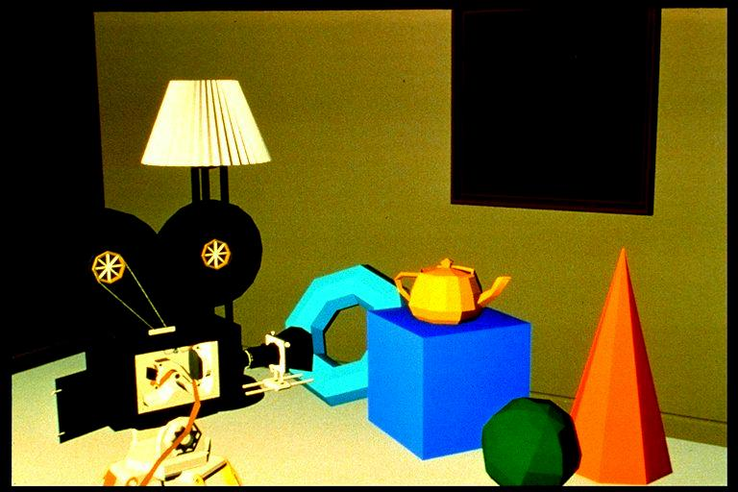
No Surface Rendering Vs Flat Surface Rendering
No Surface Rendering
Flat Surface Rendering

Slide 64
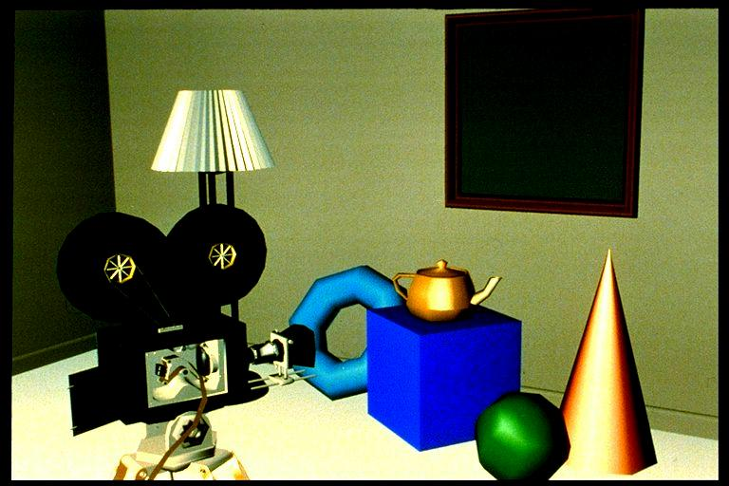
Gouraud Surface Rendering

Slide 65
No Surface Rendering Vs Flat Surface Rendering
Flat Surface Rendering
Gouraud Surface Rendering

Slide 66
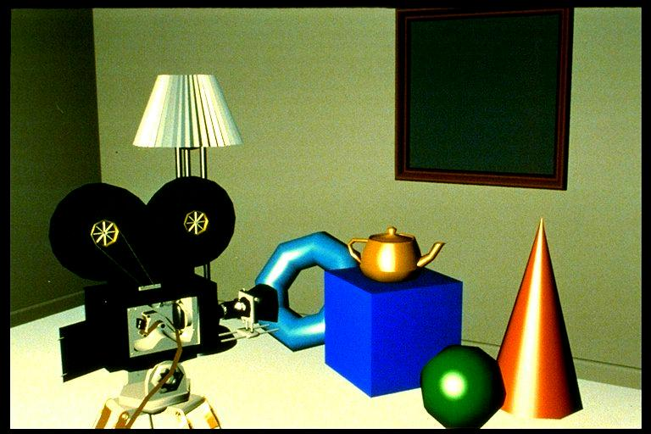
Phong Surface Rendering

Slide 67
No Surface Rendering Vs Flat Surface Rendering
Gouraud Surface Rendering
Phong Surface Rendering

Slide 68
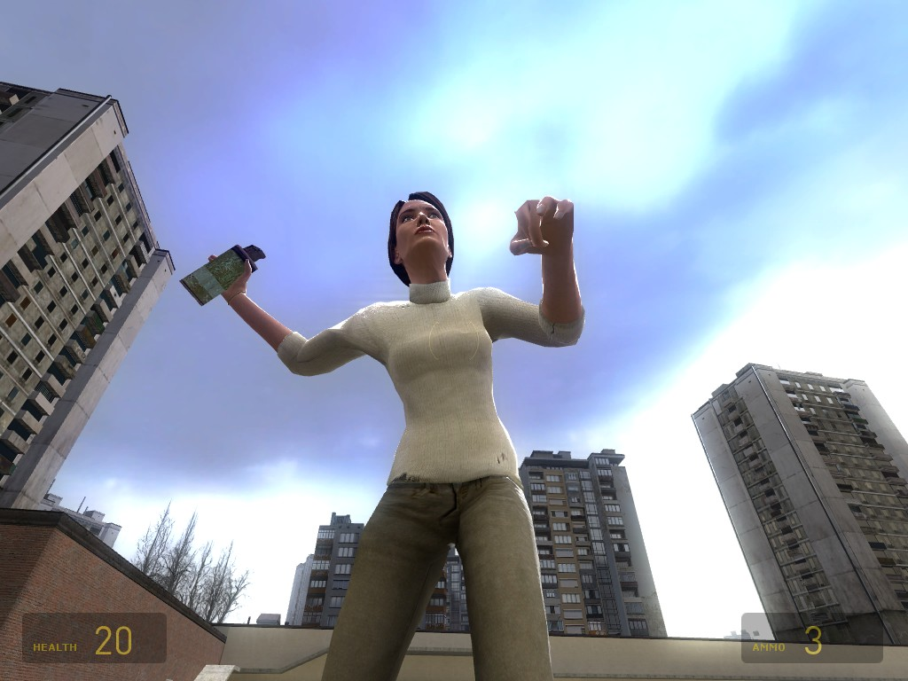
Phong Shading Examples

